Slide 1
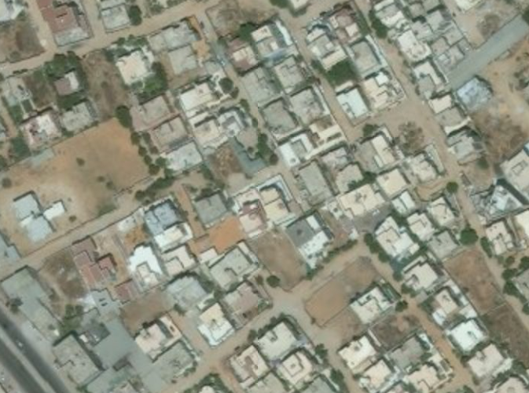

TARGET: JOHN SMITH
UNCLASSIFIED (EXAMPLE)
2-I ID
NUMBER: UN4588 AREA: GOTHAM STREET: HOUSE:
Targeted by: 2-1 ID Area of Operations: HH 2-7 Trigger: HUMINT
DOI: 16 OCT 2013
TASK: DETAIN
GRID: 33S US 33322 33159
PHYSICAL DESCRIPTION
Last given bed down grid for John Smith is from 13 SEP 2013 IIR 13-DC-12-34-88-89
Sex: Male
Age: 58
Height: 6’1”
Body Comp: Heavy
Eyes: Blue
Hair: Grey
Other details: Western style clothing, poss. Possible Eastern European acccent.
4
TARGET INFORMATION
Target Category: Terror cell
Impact: Disrupt terror cell
Possible aliases: Unknown
Vehicle: Poss Toyota Landcruiser
Family: Unknown
Religion: Unknown
STATUS:
PID:
✓
TARGET SUMMARY: John Smith is an international terrorist. He has been linked to several attacks and supplies weapons and explosives training.
Source:
✓
Location:
X
Intnl Cost:
✓
Source: HUMINT
Evidence:
✓
Trigger:
?
UNCLASSIFIED (EXAMPLE)
Last update with: HUMINT

